Slide 1
Introduction of NL-53 Series
Notes:
Finally released in June
By the time we finish this presentation you will know the selling points to explain to customer

Slide 2
“Exploring the Possibilities of Noise Measurement”
NL-43
Class 2 Sound Level Meter
NL-53
Class 1 Sound Level Meter
NL-63
Class 1 Sound Level Meter
With low-frequency sound
measurement function
Notes:
Here are the three models.
Class 2 and Class 1
Can you explain the difference between Class 2and Class 1??

Slide 3
Quick Review
 | NL-43 | NL-53 | NL-63
Feature | ”Type 2“ | Standard SLM | LOW frequency measurement
Application | Construction, Occupational Health (Japan, SE Asia) | Motor, Compressor | Windmill
Standard | IEC 61672-1:2002 Class 2, | IEC 61672-1:2002 Class1 | IEC 61672-1:2002 Class1 ISO 7196:1995
Frequency range | 20 Hz to 8 kHz | 10 Hz to 20 kHz | 1 Hz to 20 kHz
Tolerance (1kHz) | ±1.0 dB | ±0.7dB | ±0.7dB
Notes:
A quick review.
There are two major difference between Class 2 and Class1. The accuracy and frequency range.
Frequency range for Class 2 …, Class 1 ….

Slide 4
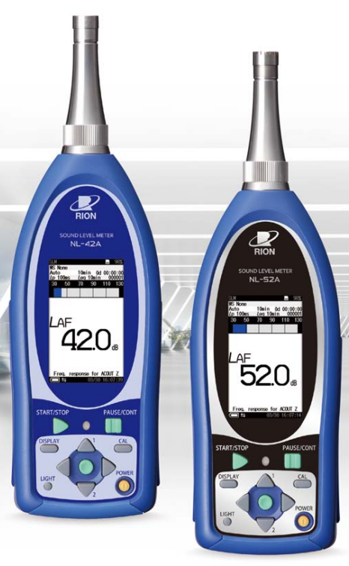
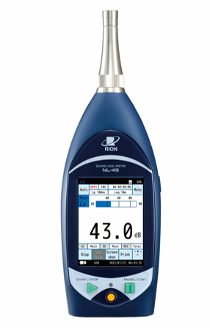
Differences in appearance: NL-42A/52A vs NL-43/53
Notes:
Difference in appearance. What do you notice?
Number of buttons, size of LCD display
Combines physical keys and touch panel operation
Operation is intuitive and user interface is easy-to-understand

Slide 5
What is the NL-53 series?
The NL-53 series enhances the connectivity to other devices and maintains the high quality of the previous models for unattended noise monitoring.
Former NL series
The NL-53 series
Quality handheld SLM for attended noise measurement
Quality handheld SLM for attended noise measurement
+
Easy connectivity for unattended noise monitoring
Notes:
Slogan: Quality, the RION promise. High quality = Measurement result is reliable ( it is traceable to international metrology standard国際計量標準).
It doesn’t break easily. It can be used for many years without giving trouble (we keep 8 years worth of parts stock after the product is finished manufacturing). Water-proof.
The high quality is the same as previous model.
Concept is to CONNECT. The new SLM has easy connectivity for unattended noise monitoring

Slide 6


Why Unattended Noise Monitoring?
Previously…
Future
Installation
Data collection
Installation
Data collection
Need to visit the site twice
to complete measurement task
Remote data acquisition
requires only 1 visit
Notes:
Unattended noise monitoring is the trend and requirement for many users today.
Previously, for noise monitoring you had to visit the site, set the sound level meter, go back to office.
A day/week later go visit the site again to collect data saved on SD card; start the meter again… go back to the office…. Had to visit the site several times to complete measurement task.
With new sound level meter, remote data acquisition requires only 1 visit.
You visit the site and set the sound level meter, go back to office, monitor and collect data while you are in the office.

Slide 7
New Features and Functions
・LAN port
・USB Type-C connector
・Touch screen
・New measurement parameters
Notes:
Must introduce features….
There are two features that is first in Japan.

Slide 8
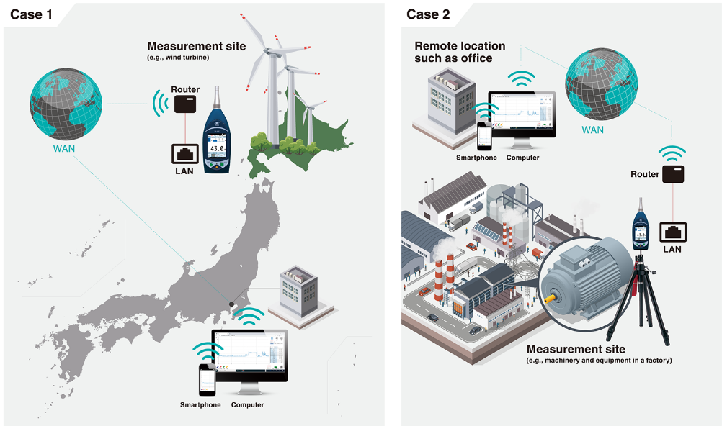
LAN Connectivity
Simplify the whole noise monitoring system
LAN port
Notes:
1. First in Japan (ACO does not have it)
It has LAN terminal for strengthening the network connection with other communication devices
It has Web app for easy noise monitoring via a PC or smartphone web browser

Slide 9
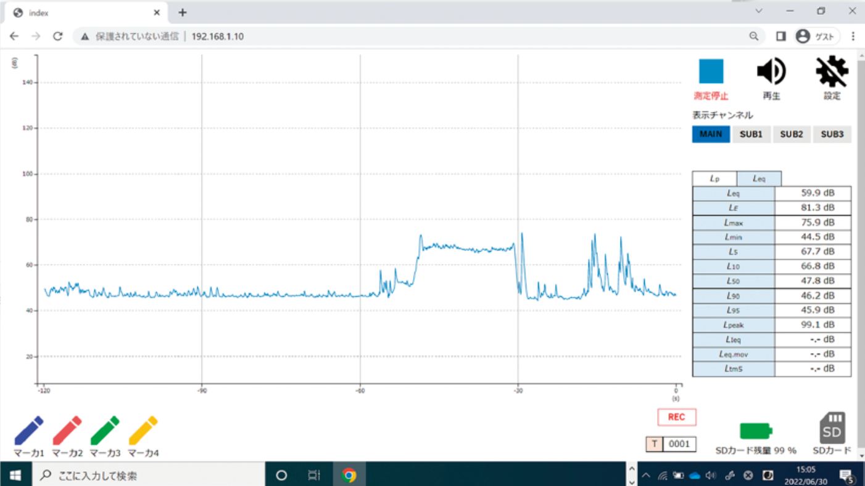
LAN Connectivity
Enables remote access and measurement operations from a web browser on a PC (Web application)
Notes:
You can monitor noise level, listen to noise, change settings of the sound level meter from the PC.

Slide 10
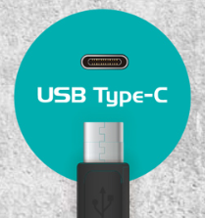
USB Type - C Connector
Power supply from portable charger through USB Type - C
Notes:
2. First in Japan
Power supply, communication, and data collection can be done with this USB Type-C cable
モバイルバッテリ（5000mAhで24ｈ動作）
Although a dedicated AC adapter is recommended for power supply.
it is possible to supply power from a commercially available smartphone charger equipped with a USB Type-C connector or from a PC's USB port.
Environmentally friendly by reducing the use of disposable batteries

Slide 11
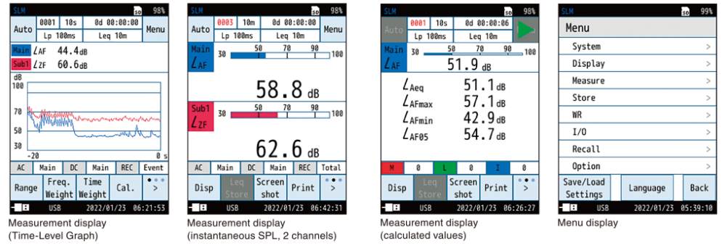
Easy to Operate
Intuitive and easy-to-understand user interface by combining physical keys and touch panel operation
Notes:
Full touch panel + 3 hardware keys-
Large LCD in a small body for easy operation.
Intuitive operation without the need for a manual

Slide 12
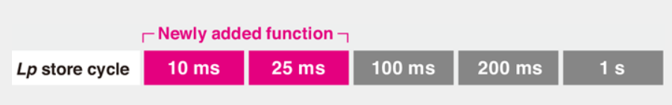
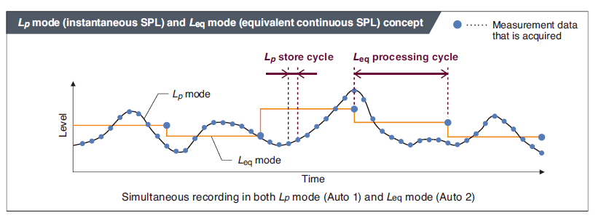
Short time Lp store (EX)
Addition of 10 ms and 25 ms-
Effective for understanding steep changes in sound pressure level over a short period of time
Notes:
Short Lp store (with NX-43EX)
Added 10ms, 25ms
Short time Lp store (EX)- 10ms,25ms,100ms,200ms,1s
Helps for evaluating an abrupt sound (sudden), requirement from EU market
100ms = takes data every 0.1 second
10m = every 0.01 second

Slide 13
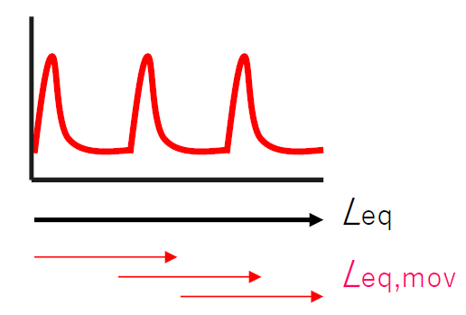
Enhanced Measurement Functions
Moving Leq
Displays the calculated value of moving equivalent continuous sound level
Notes:
ベルギーの規格
バー、コンサートなどの評価値
Belgian Standards
Evaluation value for bars, concerts, etc.

Slide 14
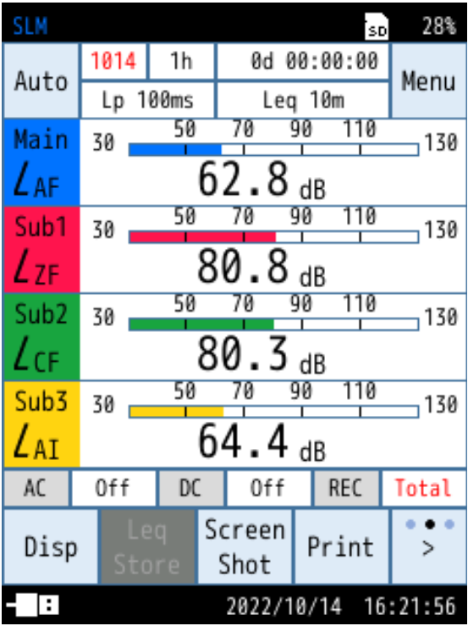
Enhanced Measurement Functions
Simultaneous measurement for up to 4 channels
e.g. Measurement of
LAF、LCF、LAI、LZF
Notes:
Simultaneous 4-channel operations and stores are possible-
For example, LAF, LAS, LCF, and LZF can be measured at the same time
Different frequency weighting and Time weighting for consultants. Health centeres.
The NL-42 series could not do this. 2 channel.
- For low-frequency sound measurement ,LAF, LGS, LZS (LPF 100Hz)

Slide 15
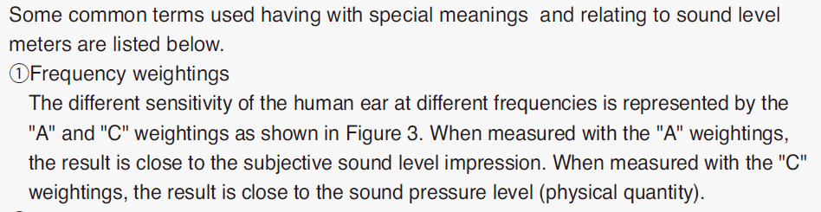
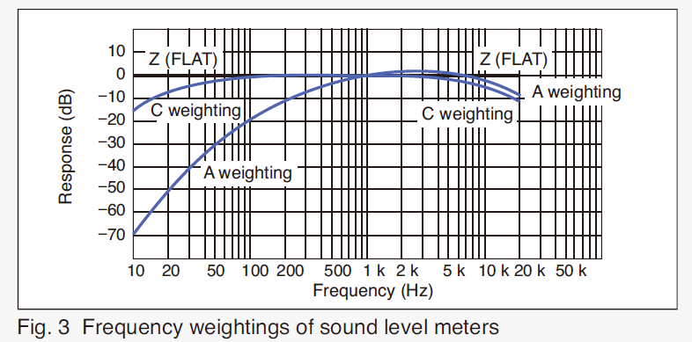
Quick Review: Frequency Weightings

Slide 16
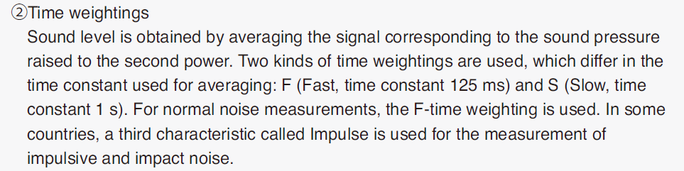
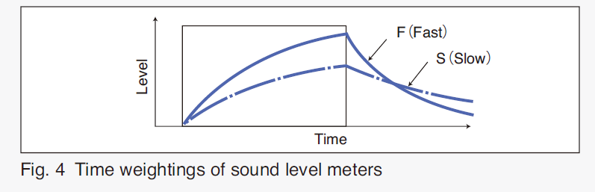
Quick Review: Time Weightings

Slide 17
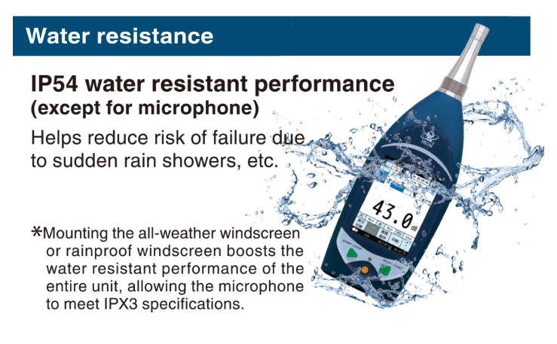
Water Resistance
Notes:
This distinguishes from cheaper sound level meter

Slide 18
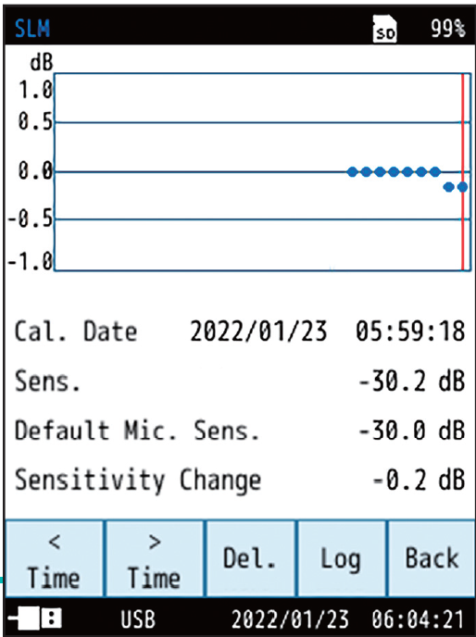
Calibration History
Calibration history can be viewed and saved to manage the measurement accuracy of the instrument
Notes:
音響校正時の感度調整、履歴を保存することで、マイクロホン
を含む騒音計の感度変化を管理。（最大30件）
• 測定精度の管理に活用。
• SDカードへコピー可能
マイクロホン感度変化が一目で分かるため計測器管理に役立てることができる
Easily manage and keep track of the calibration history of sound level meters.-
Manage changes in sensitivity of sound level meters including microphones by adjusting sensitivity during acoustic calibration and storing the history.
The sensitivity change of sound level meter including microphone can be managed by saving the sensitivity adjustment and history at the time of acoustic calibration. (up to 30 items).- Utilized for management of measurement accuracy.- Copying to SD card is possible.

Slide 19
Quality – The RION Promise
All made by RION, in Japan including microphones

Slide 20
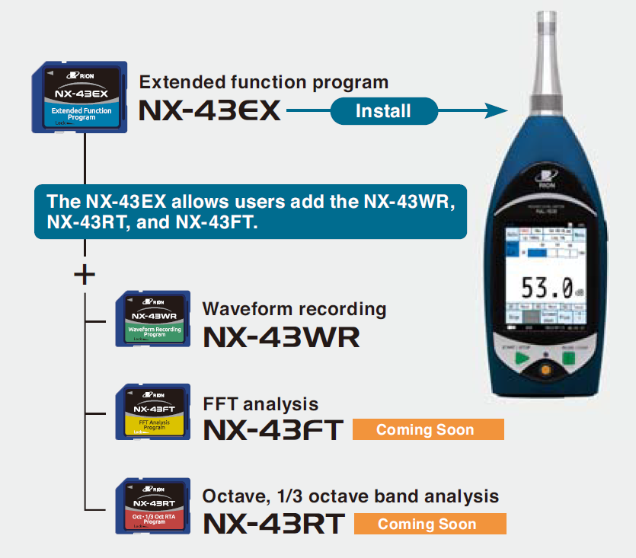
Optional Programs
STIPA
Reverberation time
Notes:
STIPA 欧州規格 声の明瞭度 教室などの音環境の評価
(Speech Transmission Index for Public Address System)
Evaluate Classroom, meeting rooms, shopping mall, stadium
Study that certain noise environment will help students concentrate and learn better.
Noise level, reverberation time, background noise etc

Slide 21
Application
Environment
Construction, factory, traffic, urban, Karaoke noise
Occupational health
Industrial
Research and development
Quality control
Inspection in line
Notes:
CDC Health Centers, Karaoke noise,

Slide 22

Building LAN environment ① When using a wired connection
Connect PC and the meter with LAN cable
Set IP address
Make sure that the last digit of the PC's IP address is different from that of the sound level meter
Launch Web App
Enter IP address into PC browser
LAN cable
Notes:
There are several ways to build LAN environment
IPアドレス設定イメージ：PCと騒音計の関係を親と子とし、苗字は同じで名前は違う
騒音計の設定
メニュ→ I/O →LAN Function ON, DHCP ON（これがオンになるとIPアドレスでてくる）、Web App ON
PCの設定
コントロールパネル→共有ネットワーク情報→アダプター設定→イーサーネット→プロトコール
SLMのIPアドレスと末尾を変える 例）SLM 192.168.1.10の場合 PC 192.168.1.11にしてみる
PCのクロム立ち上げて、SLMのIPあdレス入力する
User Name： USER
Passoword：0000

Slide 23

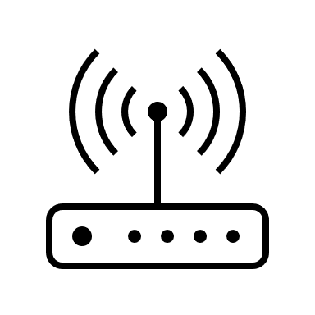
Building LAN environment ② When using wireless
Connect the sound level meter and travel router with a LAN cable
Connect your PC wirelessly to your travel router
Turn on the sound level meter's DHCP and set the sound level meter's IP address automatically
Launch Web App
Enter IP address into PC browser
Wireless LAN
LAN cable
Travel router
Notes:
市販のトラベルルーターは絶対的なIPアドレスを持っている＝親機
トラベルルーターと騒音計はLANケーブルでつなぎ、トラベルルータとパソコンは無線LANでつなぐ
従って、騒音計とPCはトラベルルータの子となるイメージ
トラベルルータは、グローバルIPアドレス持っていない

Slide 24
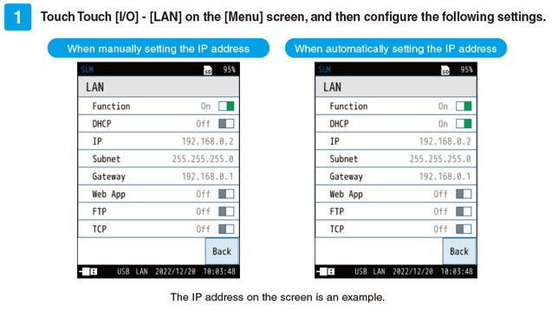
How to set IP address automatically
Notes:
騒音計の設定
メニュ→ I/O →LAN Function ON, DHCP ON（これがオンになるとIPアドレスでてくる）、Web App ON
PCの設定
コントロールパネル→共有ネットワーク情報→アダプター設定→イーサーネット→プロトコール
SLMのIPアドレスと末尾を変える 例）SLM 192.168.1.10の場合 PC 192.168.1.11にしてみる
PCのクロム立ち上げて、SLMのIPあdレス入力する
User Name： USER
Passoword：0000

Slide 25

Building LAN environment ③ When using an internal LAN
Connect the sound level meter and the company LAN with a LAN cable
Connect the PC to the company LAN (wireless)
Set IP address automatically
Launch Web App
Enter IP address into PC browser
Internal LAN
LAN cable
Wireless LAN
Notes:
社内LANと接続するなら、工場内と事務所

Slide 26

Building LAN environment ④ When using a mobile router
Connect the sound level meter and mobile router with a LAN cable
Set IP address automatically
Launch Web App
Enter IP address into PC browser
Wireless LAN
Internet
LAN cable
Mobile router
Notes:
グローバルIPアドレスに接続すれば、世界中に接続可能

Slide 27
Web App
・Chrome is recommended​
・Sound level meter and web browser are one-to-one
​・Download one file at a time
・WAV files are not compressed
Notes:
• ウェブブラウザ： Chromeを推奨。NL-43とは1対1。ダウンロードは1ファイルずつ。通信環境に
依存するため、環境が良好なことは重要。スマホは主にリアルタイムモニタ、設定確認の用途。
Web Browser: Chrome recommended, one-to-one with NL-43, download one file at a time.
It is important to have a good communication environment.
Use a smartphone mainly for real-time monitoring and setting confirmation.

